Slide 1
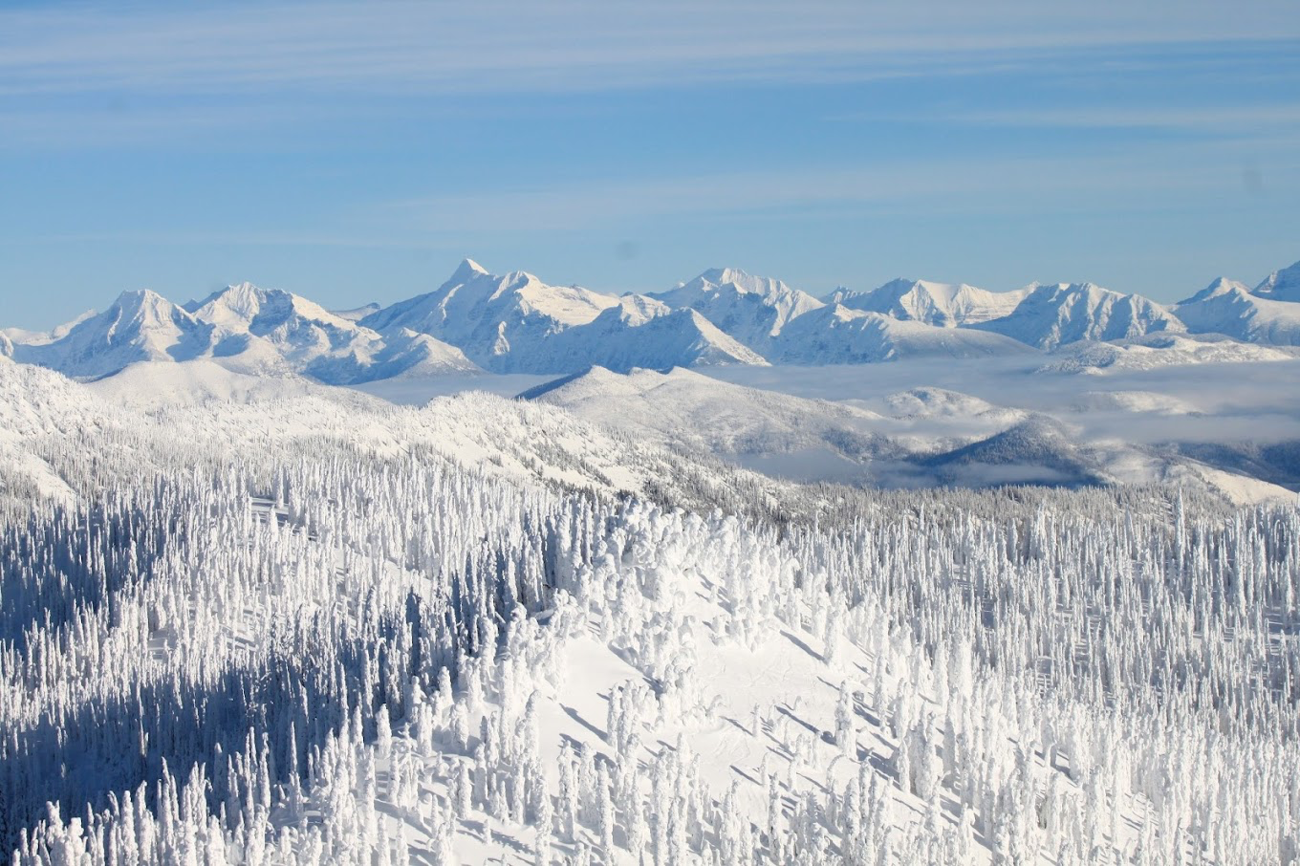
Big Mountain Resort

Slide 2
BMR just invested 1.54 M into another lift and needs to redistribute costs in a way that captures more value within the next year that is greater than market value.
Context:
BMR would like to capture more value for what the ski resort offers besides using a market value approach. Im tasked with finding a way to capture more value
Criteria for success:
If BMR is able to capture more value that is greater than what market value is offering, then the project will be deemed successful.
Scope of solution:
I will focus on capturing value by showing what all BMR has to offer versus other competitors.
Constraints within solution space:
We need to capture value in a way that does not make the cost of coming to the resort too high, which would intern turn customers away from the resort and go to other less expensive resorts.
Stakeholders to provide key insight:
Executives
Key data sources:
How many lifts do other resorts have, the degree of vertical drop, how much skiable terrain, and the cost of tickets for weekday and weekend

Slide 3
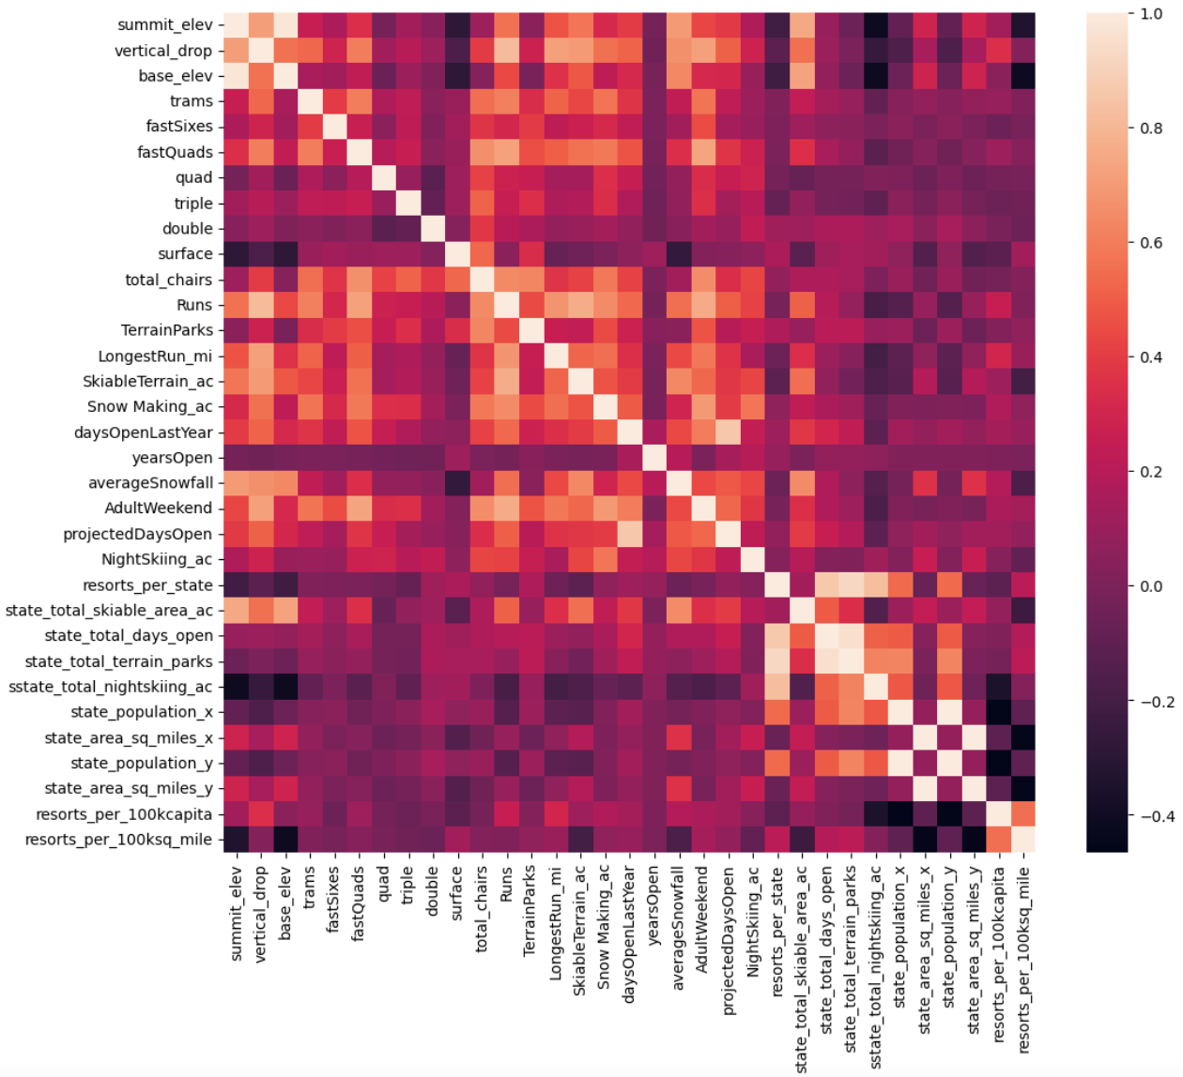
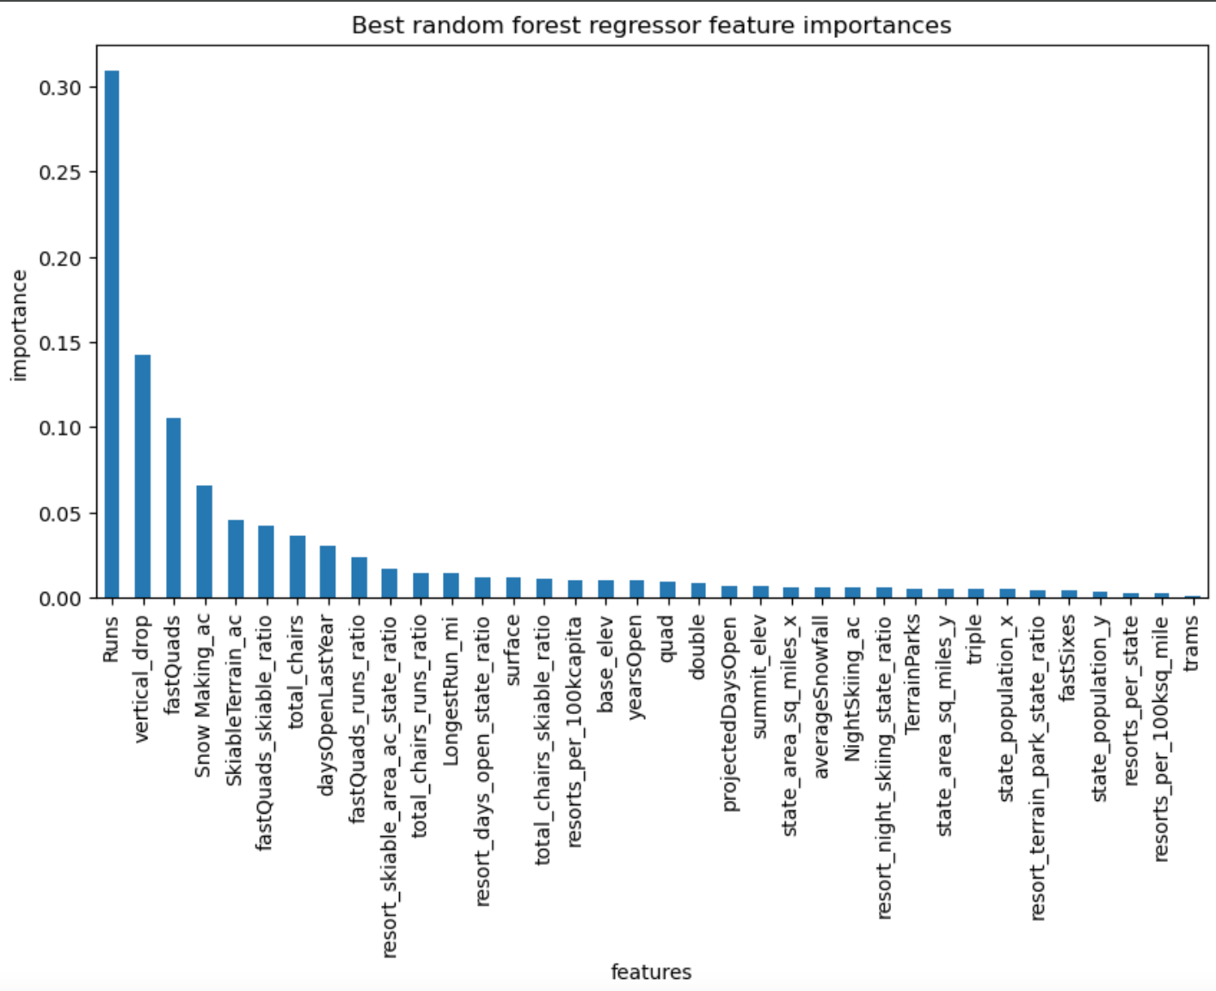
I suggest raising the price to $92.17 considering what all Big Mountain has to offer and to also close down 3 to 5 runs that are the least used or favorite among skiers.
Initially a heat map was used to find similarities within the data set. From this we kept in mind the similarities and performed further analysis.
By applying a random forest regressor we were able to find the most important features. These include runs, vertical drop, and fastQuads.

Slide 4
Modeling and Results
Our first model prediction showed us that Big Mountain should be charging $92.17 for tickets versus the current price point of $81.
This could be due to the fact that Big Mountain has more to offer than other resorts, including that it came in on the top 5 for chairs, snow maker ac, runs, and skiable terrain.

Slide 5
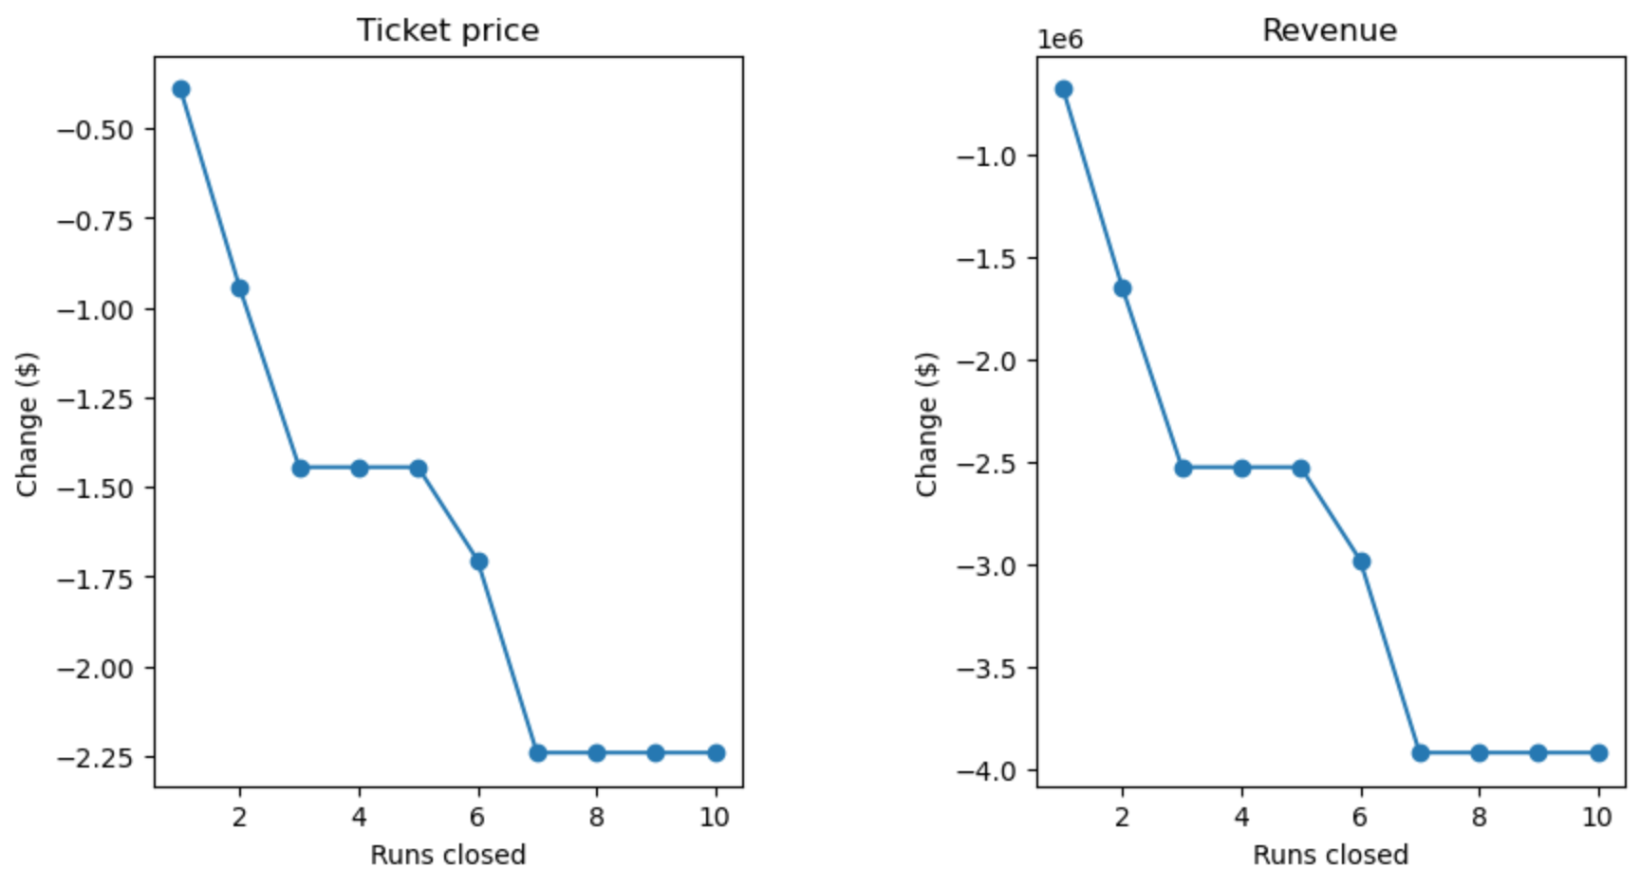
Modeling and Results
Further analysis showed that there wasnt much variability in closing one or two runs and that closing between 3 to 5 runs was the best measure for cost analysis.

Slide 6
Modeling and Results
Three scenarios were created and modeled to see their results against a price of a ticket and money to be generated that year:
The run, increasing the vertical drop by 150 feet, and installing an additional chair lift:
This scenario increases support for ticket price by $1.24
Over the season, this could be expected to amount to $2,171,296
Repeating the previous one but adding 2 acres of snow making:
This scenario increases support for ticket price by $1.24
Over the season, this could be expected to amount to $2,171,296
Increasing the longest run by .2 miles and guaranteeing its snow coverage by adding 4 acres of snow making capability:
This resulted in zero change

Slide 7
Summary and conclusion
By applying a random forest regressor we were able to clearly see what features offered were the most important and how those features were distributed across all resorts.
Big Mountain came in the top 5 of several features, which leads us to believe that Big Mountain has more to offer than other resorts and should be charging more based on those findings.
I suggest increasing the price to $92.17 and closing 3 to 5 of the runs that are least like by skiers

